Slide 1
Breast Cancer Classification Using SVM and Neural Networks
RUTGERS-School of Health Professions
Department of Health Informatics
MACHINE LEARNING TECHNIQUES
Spring-2025
Course Number: BINF5125
Payal Vaidya

Slide 2
Introduction
Breast cancer is one of the most common cancers worldwide.
Early and accurate diagnosis improves survival rates.
Machine Learning models can assist in automated diagnosis.
The project uses the Breast Cancer Wisconsin (Diagnostic) Dataset.
Aim: Develop classification models using Python.

Slide 3
Objectives
Build and evaluate machine learning models (SVM and Neural Network).
Compare model performance based on different settings.
Investigate the effect of different data splits.
Identify the top predictive features for classification.

Slide 4
Research Questions
Which classification model (SVM with different kernels, Neural Network) provides the highest accuracy and best ROC-AUC score?
How does changing the random train-test split (random_state) impact model stability and performance?
How does reducing the number of input features (from all features to top features) influence classification accuracy and robustness?
Which models maintain the best balance of precision, recall, and F1-score across different settings?
Can simpler models with fewer features still achieve comparable diagnostic performance for breast cancer prediction?

Slide 5
Methodology
Loaded dataset using pandas.
Handled missing values by replacing '?' and dropping incomplete rows.
Standardized features using StandardScaler.
Split data into 80% training and 20% testing (random_state=42 and 7).
Trained three different models:
SVM with linear kernel
SVM with RBF (radial basis function) kernel
Neural Network (MLPClassifier)
Evaluated models using accuracy score, confusion matrix, ROC Curve, and classification report.
Repeated the experiment with a new train-test split.
Identified top predictive features and retrained models.

Slide 6
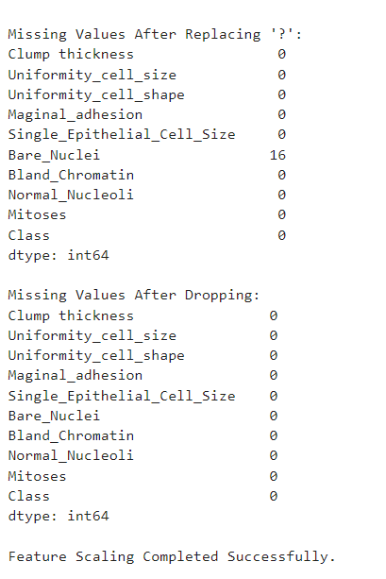
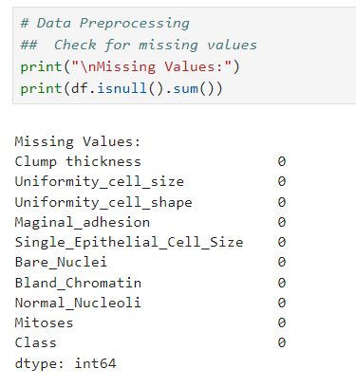
Initially checked for missing values: no missing values detected.
Found that missing entries were hidden as '?' symbols (not true NaN).
Replaced all '?' with NaN to correctly identify missing values.
Detected 16 missing values in the Bare_Nuclei feature.
Removed rows with missing data to clean the dataset.
Final dataset: No missing values and ready for feature scaling.

Slide 7
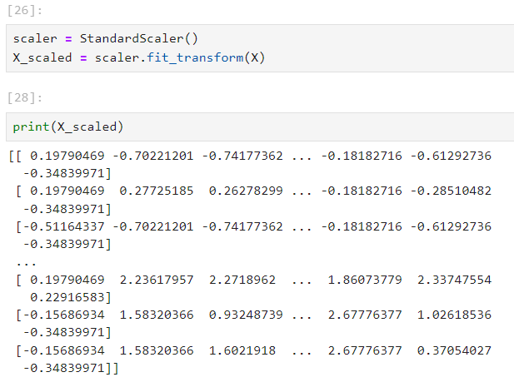
Feature Scaling
Applied StandardScaler to normalize feature values. Ensured features had zero mean and unit variance. Improved model performance and training stability.

Slide 8
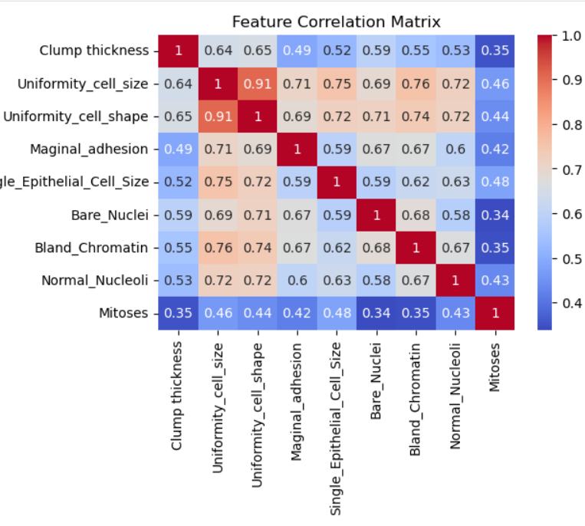
Feature Correlation Analysis
Created a correlation heatmap to visualize relationships between features.
Found high correlation (0.91) between Uniformity_cell_size and Uniformity_cell_shape.
Several features showed moderate to strong correlation with each other.
High correlation suggests potential redundancy between some features.
Decision: We keep all features to preserve model information and maximize predictive power.

Slide 9

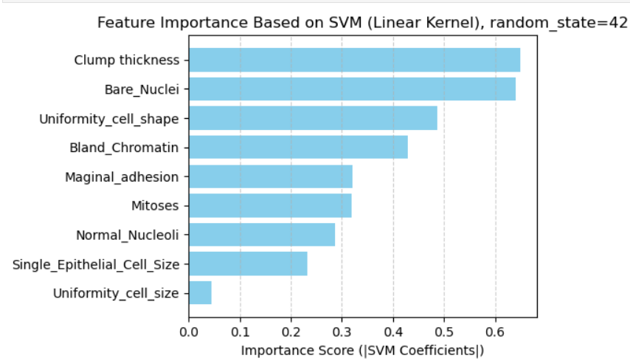
Results

Slide 10
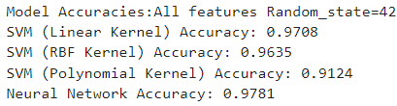
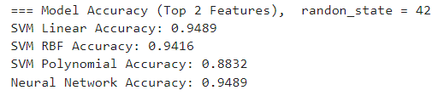
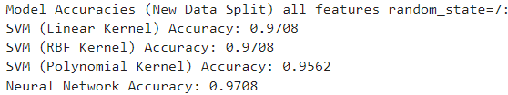
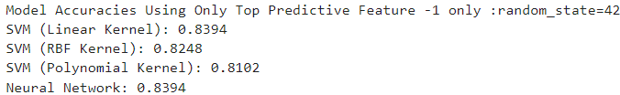

Slide 11
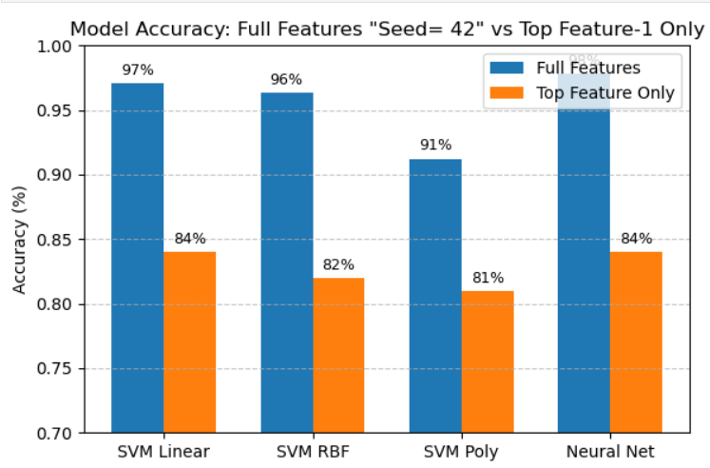

Slide 12
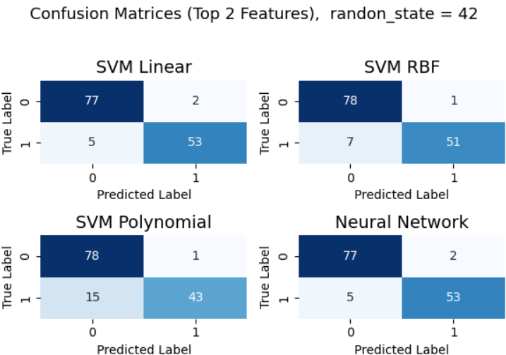
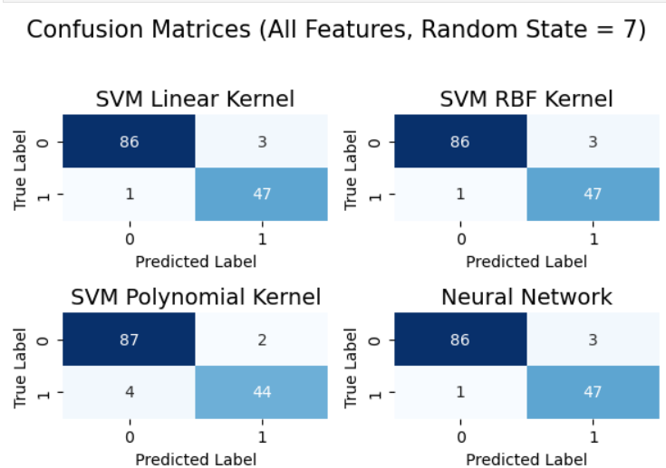
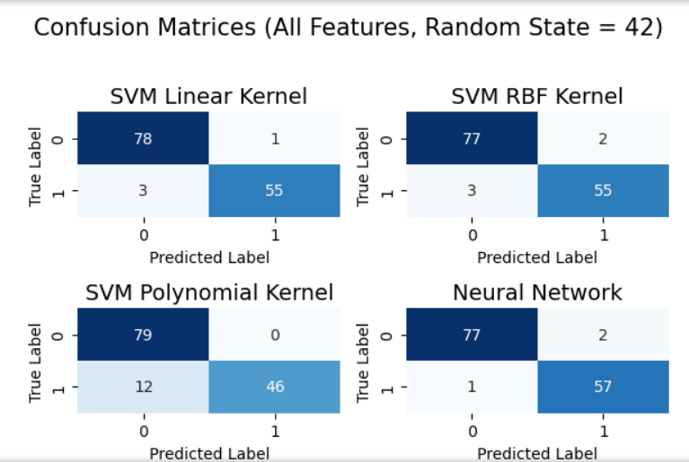
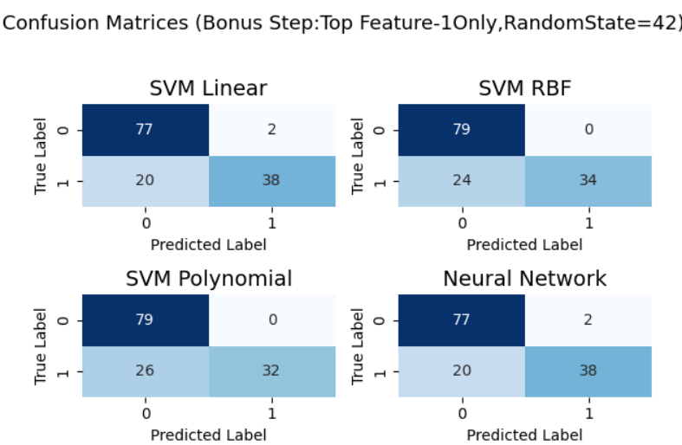

Slide 13
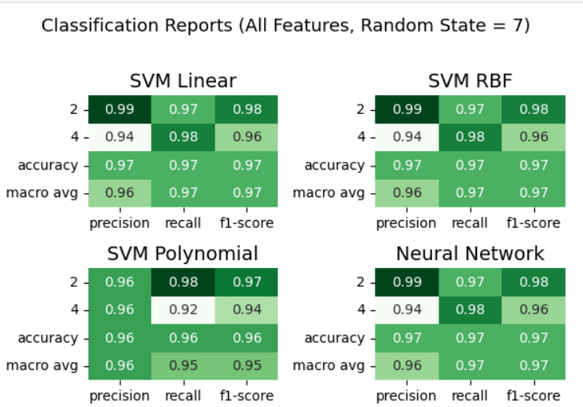
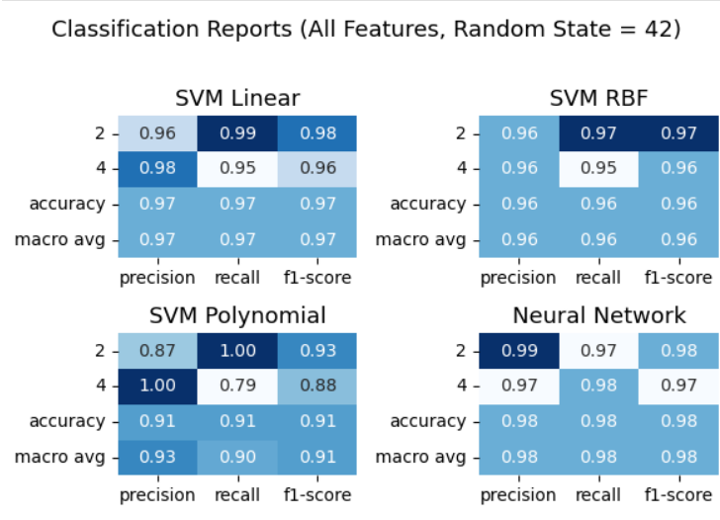
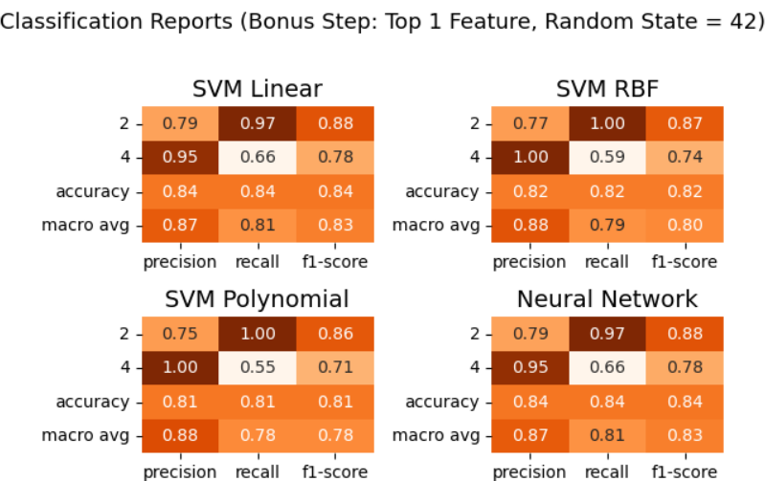
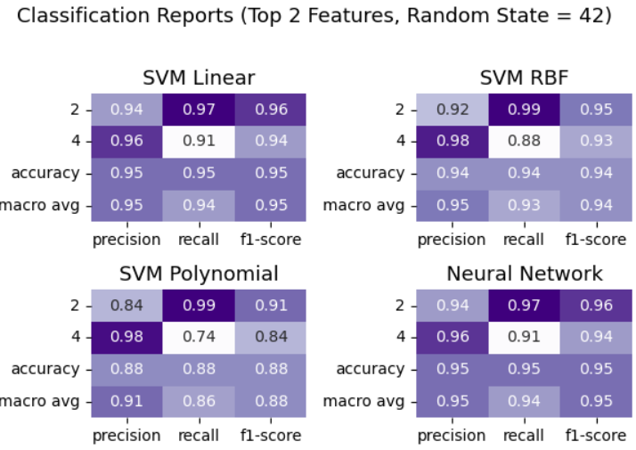

Slide 14
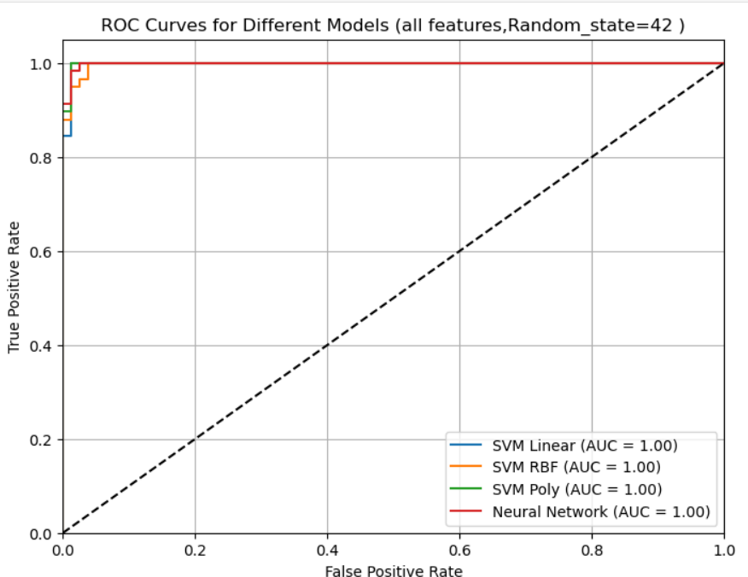
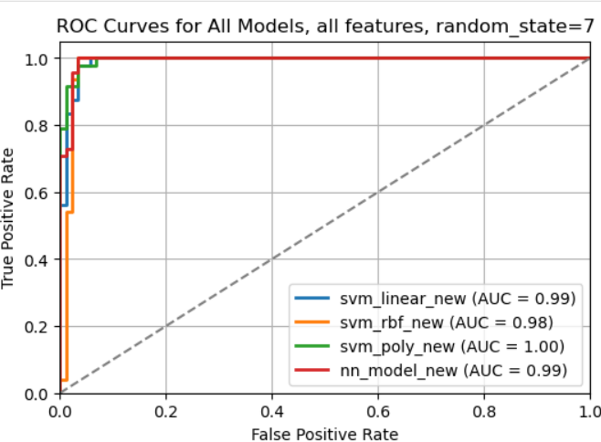
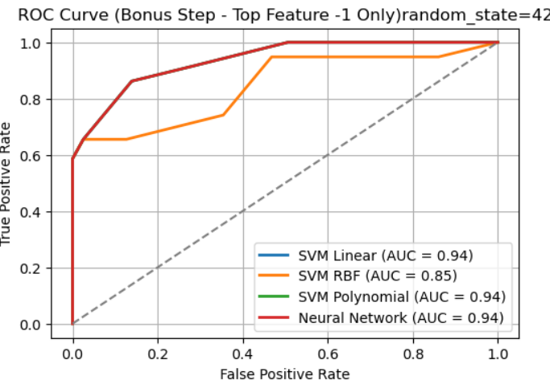
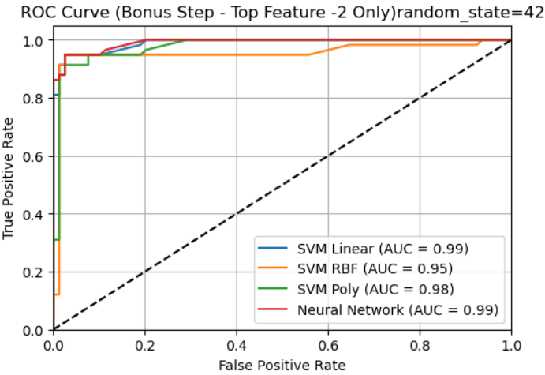

Slide 15
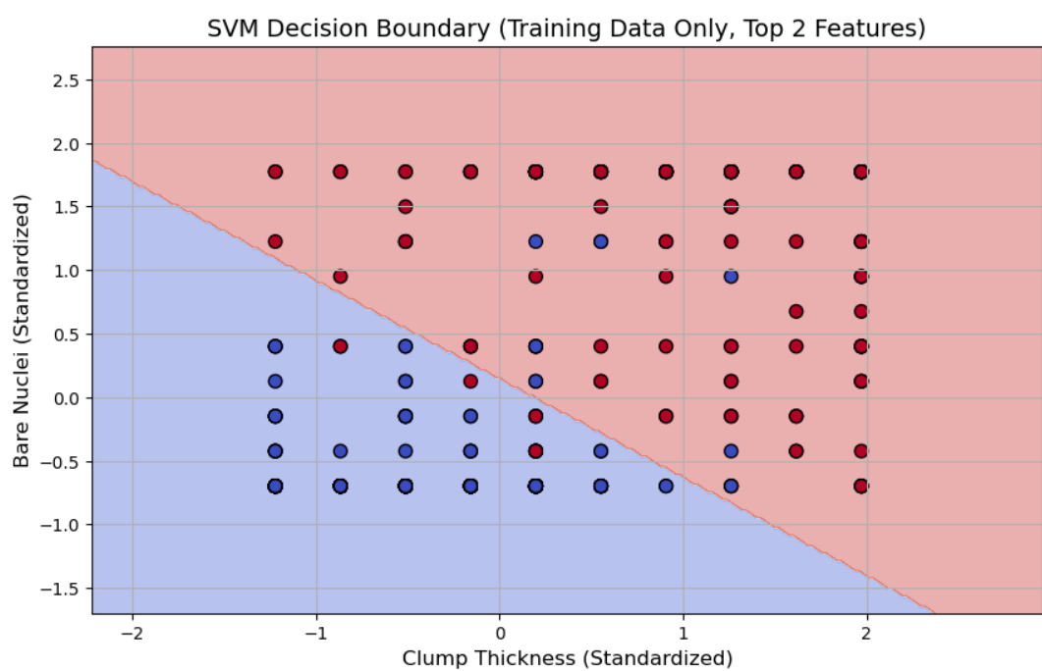

Slide 16
Discussion
In this project, we used the Wisconsin Diagnostic Dataset to investigate various machine learning models for breast cancer classification. Using all features, just the top two features, and just the top one feature, we compared the model's performance under various scenarios. In every experiment, the neural network and SVM linear models produced the best results in terms of accuracy, precision, recall, and F1-scores. Our models' robustness was demonstrated by the minimal effect that altering the random train-test split (random_state=42 vs. random_state=7) had on model performance and stability.

Slide 17
Discussion
While decreasing to just one feature resulted in notable performance decreases, reducing all features to just the top two still maintained great accuracy.
According to ROC curve research, models performed poorly when utilizing only one feature but had outstanding classification abilities when using all features or the top two features. These results were corroborated by confusion matrices and classification reports, which revealed a higher rate of misclassifications and a worse precision/recall with fewer characteristics. All things considered, feature selection is essential to striking a balance between predictive strength and model simplicity.

Slide 18
Conclusion
In terms of accuracy, precision, recall, and ROC-AUC, neural network models provided the best overall results, closely followed by SVM linear models. Diagnostic performance was considerably enhanced by utilizing several powerful features as opposed to just one. Although they can still function very well, simpler versions that only use the most important capabilities are less dependable than those that use all of the features. Our research emphasizes how crucial it is to choose models and features carefully when developing reliable classification systems for use in medical settings. Future research could further enhance classification performance by experimenting with feature engineering, ensemble approaches, and hyperparameter tuning.

Slide 19
References
Wolberg, W. H., & Mangasarian, O. L. (1990). Cancer diagnosis via linear programming. SIAM News, 23(5), 1–6.
Dua, D., & Graff, C. (2019). UCI Machine Learning Repository: Breast Cancer Wisconsin (Diagnostic) Data Set. University of California, Irvine, School of Information and Computer Sciences. https://archive.ics.uci.edu/ml/datasets/Breast+Cancer+Wisconsin+%28Diagnostic%29
Cortes, C., & Vapnik, V. (1995). Support-vector networks. Machine Learning, 20(3), 273–297. https://doi.org/10.1007/BF00994018
Pedregosa, F., Varoquaux, G., Gramfort, A., Michel, V., Thirion, B., Grisel, O., ... & Duchesnay, É. (2011). Scikit-learn: Machine learning in Python. Journal of Machine Learning Research, 12, 2825–2830.
Bishop, C. M. (2006). Pattern recognition and machine learning. Springer.
Han, J., Kamber, M., & Pei, J. (2011). Data mining: Concepts and techniques (3rd ed.). Morgan Kaufmann.
Chollet, F. (2017). Deep learning with Python. Manning Publications.
Fawcett, T. (2006). An introduction to ROC analysis. Pattern Recognition Letters, 27(8), 861–874. https://doi.org/10.1016/j.patrec.2005.10.010
Ng, A. Y. (2004). Feature selection, L1 vs. L2 regularization, and rotational invariance. In Proceedings of the Twenty-first International Conference on Machine Learning (ICML) (pp. 78–85). https://doi.org/10.1145/1015330.1015435
Hastie, T., Tibshirani, R., & Friedman, J. (2009). The elements of statistical learning: Data mining, inference, and prediction (2nd ed.). Springer. https://doi.org/10.1007/978-0-387-84858-7

Slide 20
Thank you Payal Vaidya

